Slide 1
Snake Game
Group Members : Md Zuhair (19074008, CSE - IDD Part-4) Shaan Kumar (19074015, CSE - IDD Part-4)

Slide 2
Introduction
Snake Game is the common name for a video game concept where the player moves a line that grows in length, with the line itself being a primary obstacle.
As the snake moves forward, it leaves a trail behind, resembling a moving snake.
Game Rules :
The player loses when the snake runs into the screen border, a trail, another obstacle, or itself.
There are food items present on the screen, which keep popping at random places.
As the snake eats the item, it grows in length, to make the game progressively difficult.

Slide 3
Project Introduction
Making a Neuro Genetic Hybrid System for creating a self learning snake game.
Using Genetic algorithm in the game to improve the gameplay.
Deciding the movement of the snake in the game using Feed-forward neural network.

Slide 4
Technology Used
Python
Python Libraries used in this project:
numpy - used for creating arrays and operations on array with ease.
Random - used for generating random values (in genetic algorithm)
math - used for mathematical calculations
pygame - used for displaying the snake game on screen
matplotlib - used for plotting of graphs

Slide 5
Motivation
Snake Game is a very popular game which all of us have played at least once in our childhood.
In this course, we learned about Genetic Algorithm and Neural Networks, which motivated us to get an idea of optimizing this game and get a close-to-optimal solution by creating a Neuro Genetic Hybrid System.

Slide 6
Algorithms Used
We are using a Neuro Genetic Hybrid System and hence the systems used are:
Genetic Algorithm
Feed-Forward Neural Network

Slide 7
Approach to the Problem
Dataset Generation:
For training any Machine learning algorithm, we need a lot of data, which needs to be preprocessed before being fed to the Algorithm.
It is not an easy task to get the dataset of this problem, hence we generated our dataset by playing this game again and again.

Slide 8
Approach to the Problem
Genetic Algorithm
Initialized a population of 50 snakes with randomized characteristics (weights of neural network)
We calculate fitness as follows
If the snake eat an apple : 5000 x number of apples eaten by the snake
If the snake eats itself : (-1)
If the snake hits a border : (-1)
If the snake repeats itself for a long time : (-1)
According to the fitness, we crossover some number of parents everytime and mutate the children formed using crossover.
We are using the uniform crossover method to do the crossover.
We continue this unless we reach a fixed number of generations because we cannot determine the exact number of generations when the snake will be most optimal.

Slide 9
Approach to the Problem
Feed-Forward Neural Network
Initialized all weights with random values.
We have created two hidden layers in this neural network.
Input layer consists of 7 neurons and output layer consists of 3 nodes.
Input Layer of the neural network consists of the following :
The direction of movement of the snake.
The position of the food.
The boundaries of the wall
The direction of food from the snake
Output Layer of the neural network gives us the direction in which our snake should move in the next step :
Move left
Move right
Move in the same direction
Each of the following will have some weights, and the one with maximum weight will be performed.

Slide 10
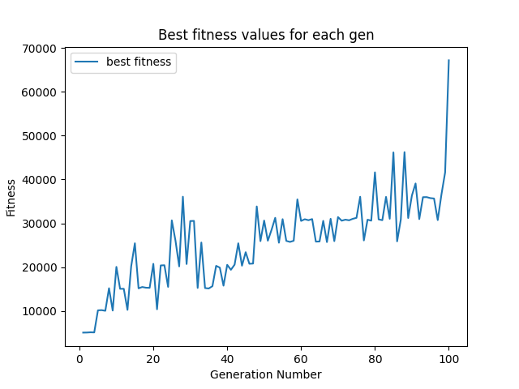
Experimental Results
Generation vs maximum fitness graph

Slide 11
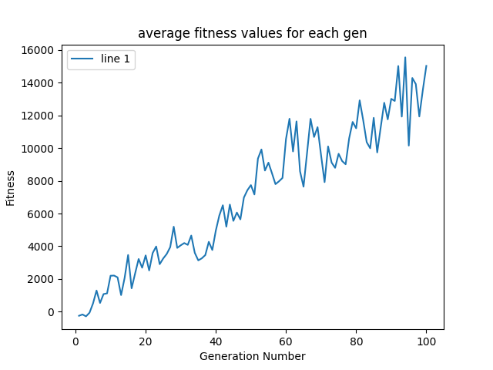
Experimental Results
Generation vs average fitness graph

Slide 12
Conclusion
From the experimental results, we can clearly see an improvement in the average and best fitness values over a course of generations which helps us conclude that our Neuro Genetic Hybrid System is working just like we expected it to be.
We have successfully solved the Snake Game problem using our Hybrid System as with a greater number of generations, the accuracy will keep on increasing.

Slide 13
Thank You

